Slide 1
ONLINE BLOOD BANKING SYSTEM
AIM: Design and implement an Online Blood Banking System through any open cloud platform.
Course Code:
CSA1590-Cloud Computing and Big Data Analytics for Virtual Clusters
Presented by:
G.Tejaswi
(192211748)

Slide 2
ABSTRACT
Modern Online Blood Banking
System Comprehensive management of registrations, inventory, and billing
Built on AWS for scalability and security
Integrated services: EC2, S3, RDS, Lambda
User-friendly frontend with React.js
Secure and compliant with healthcare standards
Advanced analytics and reporting tools
Robust backend with Django
Extensive testing for reliability and performance
Optimized deployment with auto-scaling and load balancing
Real-time monitoring with AWS CloudWatch
Enhances healthcare outcomes through efficient processes

Slide 3
INTRODUCTION
The Online Blood Banking System is designed to modernize and streamline blood donation and transfusion processes through a comprehensive digital platform.
Importance :
Enhances efficiency in managing blood donations and transfusions.
Improves accessibility for patients and donors.
Ensures better tracking and management of blood inventory.
Contributes to timely and accurate matching of blood requests.
Project Overview :
Objective: To develop a cloud-based solution for efficient blood bank management.
Key Features: User registration, blood inventory management, request handling, billing, and reporting.
Technology Stack: AWS for cloud infrastructure, React.js for the frontend, Django for the backend, with secure, scalable, and compliant solutions.

Slide 4
PROJECT REQUIREMENTS AND SCOPE
System Goals: Modernize blood bank operations, improve efficiency, and ensure secure data management.
Functional Requirements: User registration, inventory management, request handling, billing, and reporting.
Non-Functional Requirements: Scalability, security, compliance with healthcare regulations.
Scope of the Project:
Development: Design and implement an online platform.
Deployment: Utilize cloud infrastructure for hosting and scalability.
Maintenance: Ongoing support and updates post-launch.
Key Processes to Manage:
Patient Registration: Collect and manage patient details and track requests.
Blood Donor Registration: Manage donor profiles and availability.
Blood Inventory Management: Track blood stock, donations, and expirations.
Request Management: Handle and match blood requests with available inventory.
Billing: Generate and manage bills, integrate payment gateways.
Reporting and Analytics: Generate reports and analyze data for operational insights.

Slide 5
CHOOSING A CLOUD PLATFORM
Comparison of Cloud Platforms:
AWS: Broad service range, global infrastructure, strong security.
Google Cloud: Excellent for analytics, competitive pricing, good integration with Google services.
Reasons for Choosing AWS:
Comprehensive services (EC2, S3, RDS, Lambda).
Proven scalability and reliability.
Advanced security features and compliance support.
Benefits of Hosting on the Cloud:
Scalability: Adjust resources based on demand.
Accessibility: Access from anywhere with internet.
Cost-Efficiency: Pay-as-you-go model reduces costs.
Reliability: High availability and disaster recovery.
Security: Advanced protection and regulatory compliance.

Slide 6
SYSTEM ARCHITECTURE DESIGN
Overview:
Frontend: React.js (web), React Native/Flutter (mobile).
Backend: Django/Spring Boot for API services.
Database: RDS (relational), DynamoDB (NoSQL).
Storage: S3 for file and media storage.
Deployment: EC2 (hosting), Lambda (serverless functions), CloudFront (content delivery).
Security: AWS Cognito (authentication), VPC, security groups.
Factors Considered:
Scalability: Auto-scaling, load balancing.
Security: Data encryption, secure access, regulatory compliance.
Accessibility: Global access through cloud infrastructure.
Diagram Elements:
Frontend: Web and mobile applications.
Backend: API services and authentication.
Database: SQL and NoSQL databases.
Storage: File and media storage.
Deployment: Servers, serverless functions, CDN.
Security: Network protection.

Slide 7
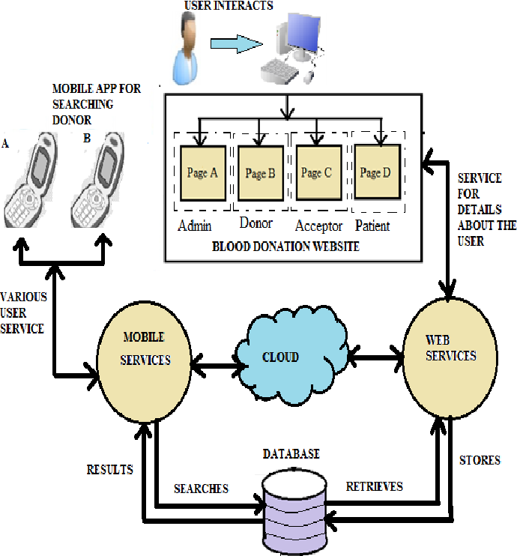
APPLICATION DEVELOPMENT
Programming Language Selection:
Python
Java
Framework Selection:
Django (Python)
Spring (Java)
Development Process Overview:
Requirement Analysis
Design (architecture, database schema, UI/UX)
Implementation
Set up development environment
Develop backend with Django/Spring
Build frontend with React.js
Integrate AWS services (EC2, S3, RDS, Lambda)
Testing
Unit testing
Integration testing
Load testing
Security and compliance audits
Deployment
Deploy on AWS
Configure auto-scaling and load balancing
Set up monitoring
Maintenance
Ongoing support and updates
Performance optimizations

Slide 8
APPLICATION TESTING
Importance of Testing:
Ensures functionality and reliability.
Identifies and fixes bugs early.
Validates performance and security.
Types of Testing Conducted:
Unit Testing
Integration Testing
Performance Testing
Results of Testing:
High code coverage and minimal bugs in unit testing.
Seamless module interactions in integration testing.
Meets performance benchmarks and handles peak loads in performance testing.

Slide 9
APPLICATION LANCH
Launch Process Overview:
Finalize testing.
Deploy to production on AWS.
Perform a soft launch for validation.
Steps Taken to Ensure a Successful Launch:
Conducted thorough pre-launch testing.
Implemented robust monitoring and logging.
Ensured scalability with auto-scaling and load balancing.
Prepared a rollback plan for quick recovery in case of issues.
Challenges Faced During the Launch:
Data migration issues.
Managing unexpected high user traffic.
Addressing last-minute security vulnerabilities.
Coordinating team efforts.

Slide 10
PERFORMANCE MONITORING
Importance of Monitoring:
Ensures application reliability and availability.
Identifies and resolves issues proactively.
Optimizes performance and resource utilization.
Enhances user experience.
Tools Used for Monitoring:
AWS CloudWatch
AWS X-Ray
New Relic
Prometheus and Grafana
Performance Metrics Tracked:
CPU and memory usage
Response times
Request rates
Error rates
Database performance
Network latency

Slide 11
USER FEEDBACK AND IMPROVEMENTS
Gathering User Feedback:
Surveys and questionnaires.
In-app feedback forms.
User interviews and focus groups.
Monitoring reviews and social media mentions.
Implementing Improvements Based on Feedback:
Prioritize feedback items based on impact and feasibility.
Plan and schedule updates to address key issues and requests.
Release regular updates and patches to enhance functionality and fix bugs.
Continuous Improvement Process:
Establish a feedback loop for ongoing user input.
Regularly review and analyze feedback data.
Integrate user suggestions into the development roadmap.
Monitor the impact of changes and refine the application accordingly.

Slide 12
SUCCESS METRICS
Key Performance Indicators (KPIs):
User adoption rate
Active user count
User satisfaction score
Response time and uptime
Number of successful blood donations and requests handled
Metrics to Measure the Success of the Application:
User Engagement: Daily active users (DAU), monthly active users (MAU).
Operational Efficiency: Average time to process requests, system downtime.
Financial Performance: Revenue generated from services, cost savings from efficiency improvements.
Scalability: System's ability to handle increased load without performance degradation.
Security: Number of security incidents, compliance with regulatory standards.
Achievements and Milestones Reached:
Successful launch with minimal issues.
Rapid user adoption and positive feedback.
Achievement of performance and uptime goals.
Significant number of blood donations and requests successfully managed.
Recognition or certifications for compliance and security.

Slide 13
CONCLUSION
Summary of the Project:
Developed a comprehensive Online Blood Banking System using AWS for scalability, security, and accessibility.
Implemented key functionalities including patient and donor registrations, blood inventory management, request handling, and billing.
Achieved successful deployment and ensured high performance through rigorous testing and monitoring.
Lessons Learned:
Importance of thorough planning and requirement analysis.
The critical role of user feedback in refining the application.
Challenges of ensuring security and compliance in healthcare applications.
Need for robust testing and continuous monitoring to maintain system reliability.
Future Enhancements and Expansions:
Integration of advanced analytics and machine learning for predictive insights.
Expansion of the mobile application for better accessibility.
Incorporation of more third-party integrations (e.g., payment gateways, healthcare providers).
Enhancement of user experience through UI/UX improvements and additional features.
Exploring global deployment to extend services to more regions.

Slide 14


